Slide 1
DIGITAL IMAGE PROCESSING
Elective 3 (5th Sem.)
MANAS KUMAR RAY
Department of Computer Application
B.B.College,Asansol

Slide 2
Image definition
Image definition:
  A 2D function obtained by sensing a scene
  F(x,y), F(x₁,x₂), F(x)
  F - intensity, grey level
  x,y - spatial co-ordinates
No. of grey levels, L = 2^{B}
B = no. of bits

Slide 3
Monochromatic images
Image processing - static images - time t is constant
Monochromatic static image - continuous image function f(x,y)
  arguments - two co-ordinates (x,y)
Digital image functions - represented by matrices
  co-ordinates = integer numbers
  Cartesian (horizontal x axis, vertical y axis)
  OR (row, column) matrices
Monochromatic image function range
  lowest value - black
  highest value - white
Limited brightness values = gray levels

Slide 4

Chromatic images
Colour
  Represented by vector not scalar
    Red, Green, Blue (RGB)
Green
Red
Green

Slide 5
Morphological Operators
Structuring Element
Erosion
Dilation
Opening
Closing
Outlook: Hit-and-miss Operation, Thinning, Thickening

Slide 6
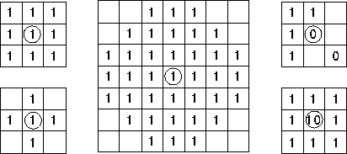
Structuring Element (Kernel)
Structuring Elements can have varying sizes
Usually, element values are 0,1 and none(!)
Structural Elements have an origin
For thinning, other values are possible
Empty spots in the Structuring Elements are don’t care’s!
Box
Disc

Slide 7
Erosion
Erosion is the set of all points in the image, where the structuring element “fits into”.
Consider each foreground pixel in the input image
  If the structuring element fits in, write a “1” at the origin of the structuring element!
Simple application of pattern matching
  Erosion shrinks foreground, enlarges Background
Input:
  Binary Image (Gray value)
  Structuring Element, containing only 1s

Slide 8


Example of erosion
White = 0, black = 1, dual property, image as a result of erosion gets darker

Slide 9

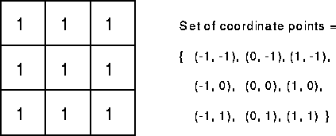
Example: Erosion
Erosion is an important morphological operation
Applied Structuring Element:

Slide 10
Example for Erosion
Input image
1 | 0 | 0 | 0 | 1 | 1 | 1 | 0 | 1 | 1
Structuring Element
1
1
1
Output Image
 | 0

Slide 11
Example for Erosion
Input image
1 | 0 | 0 | 0 | 1 | 1 | 1 | 0 | 1 | 1
Structuring Element
1
1
1
Output Image
 | 0 | 0

Slide 12
Example for Erosion
Input image
1 | 0 | 0 | 0 | 1 | 1 | 1 | 0 | 1 | 1
Structuring Element
1
1
1
Output Image
 | 0 | 0 | 0 | 0

Slide 13
Example for Erosion
Input image
1 | 0 | 0 | 0 | 1 | 1 | 1 | 0 | 1 | 1
Structuring Element
1
1
1
Output Image
 | 0 | 0 | 0 | 0 | 1

Slide 14
Example for Erosion
Input image
1 | 0 | 0 | 0 | 1 | 1 | 1 | 0 | 1 | 1
Structuring Element
1
1
1
Output Image
 | 0 | 0 | 0 | 0 | 1 | 0

Slide 15
Example for Erosion
Input image
1 | 0 | 0 | 0 | 1 | 1 | 1 | 0 | 1 | 1
Structuring Element
1
1
1
Output Image
 | 0 | 0 | 0 | 0 | 1 | 0 | 0

Slide 16
Example for Erosion
Input image
1 | 0 | 0 | 0 | 1 | 1 | 1 | 0 | 1 | 1
Structuring Element
1
1
1
Output Image
 | 0 | 0 | 0 | 0 | 1 | 0 | 0 | 0

Slide 17
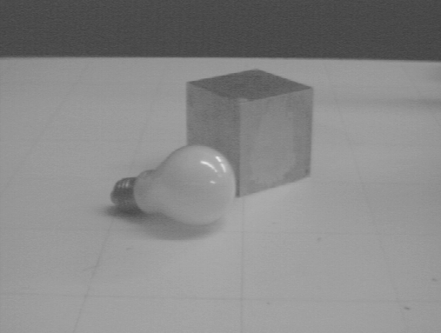
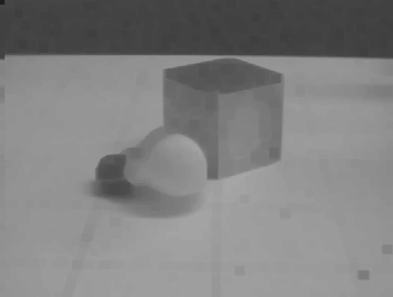
Erosion on Gray Value Images
Images get darker!

Slide 18
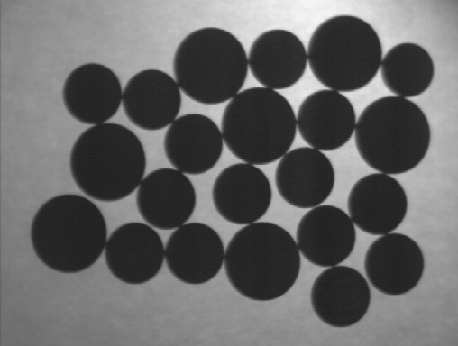
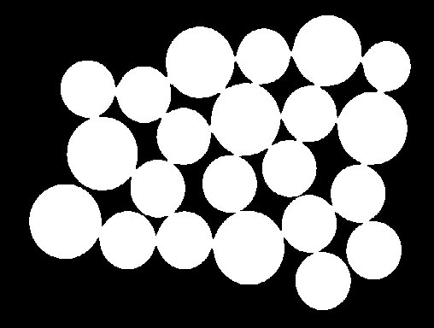

Counting Coins
Counting coins is difficult because they touch each other
Solution: Erosion separates them

Slide 19
Dilation
Dilation is the set of all points in the image, where the structuring element “touches” the foreground.
Consider each pixel in the input image
  If the structuring element touches the foreground image, write a “1” at the origin of the structuring element!
  Dilation enlarges foreground, shrinks background
Input:
  Binary Image
  Structuring Element, containing only 1s!!

Slide 20
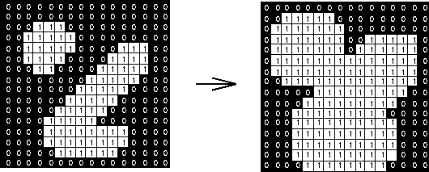
Example: Dilation
Dilation is an important morphological operation
Applied Structuring Element:

Slide 21
Example for Dilation
Input image
1 | 0 | 0 | 0 | 1 | 1 | 1 | 0 | 1 | 1
Structuring Element
1
1
1
Output Image
 | 1

Slide 22
Example for Dilation
Input image
1 | 0 | 0 | 0 | 1 | 1 | 1 | 0 | 1 | 1
Structuring Element
1
1
1
Output Image
 | 1 | 0

Slide 23
Example for Dilation
Input image
1 | 0 | 0 | 0 | 1 | 1 | 1 | 0 | 1 | 1
Structuring Element
1
1
1
Output Image
 | 1 | 0 | 1

Slide 24
Example for Dilation
Input image
1 | 0 | 0 | 0 | 1 | 1 | 1 | 0 | 1 | 1
Structuring Element
1
1
1
Output Image
 | 1 | 0 | 1 | 1

Slide 25
Example for Dilation
Input image
1 | 0 | 0 | 0 | 1 | 1 | 1 | 0 | 1 | 1
Structuring Element
1
1
1
Output Image
 | 1 | 0 | 1 | 1 | 1

Slide 26
Example for Dilation
Input image
1 | 0 | 0 | 0 | 1 | 1 | 1 | 0 | 1 | 1
Structuring Element
1
1
1
Output Image
 | 1 | 0 | 1 | 1 | 1 | 1

Slide 27
Example for Dilation
Input image
1 | 0 | 0 | 0 | 1 | 1 | 1 | 0 | 1 | 1
Structuring Element
1
1
1
Output Image
 | 1 | 0 | 1 | 1 | 1 | 1 | 1

Slide 28
Example for Dilation
Input image
1 | 0 | 0 | 0 | 1 | 1 | 1 | 0 | 1 | 1
Structuring Element
1
1
1
Output Image
 | 1 | 0 | 1 | 1 | 1 | 1 | 1 | 1

Slide 29

Dilation Example
Image get lighter, more uniform intensity

Slide 30
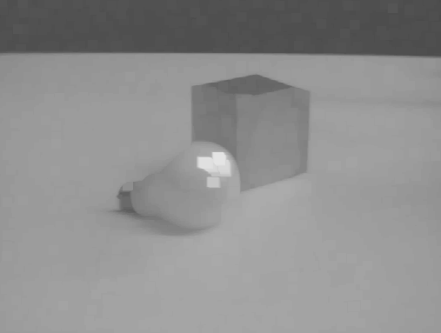
Dilation on Gray Value Images
More uniform intensity

Slide 31

Edge Detection
Edge Detection
Dilate input image
Subtract input image from dilated image
Edges remain

Slide 32
Opening
Similar to Erosion
  Spot and noise removal
  Less destructive
Erosion next dilation
the same structuring element for both operations.
Input:
  Binary Image
  Structuring Element, containing only 1s

Slide 33

Opening
Structuring element: 3x3 square

Slide 34
Closing
Similar to Dilation
  Removal of holes
  Tends to enlarge regions, shrink background
Closing is defined as a Dilatation, followed by an Erosion using the same structuring element for both operations.
Dilation next erosion
Input:
  Binary Image
  Structuring Element, containing only 1s

Slide 35

Closing
Structuring element: 3x3 square

Slide 36
Hit-and-Miss
Brief Description
  General binary morphological operation that can be used to look for particular patterns in an image.
  A tool for shape detection
  Basic operation for binary morphology
    Almost all the other binary morphological operators can be derived from Hit-and-Miss Transform.

Slide 37


Thinning
How It Works
  Thinning is the dual of thickening.
    Thickening the foreground is equivalent to thinning the background.
  The operator is normally applied repeatedly until it causes no further changes to the image.
A: image, B: structuring element

Slide 38
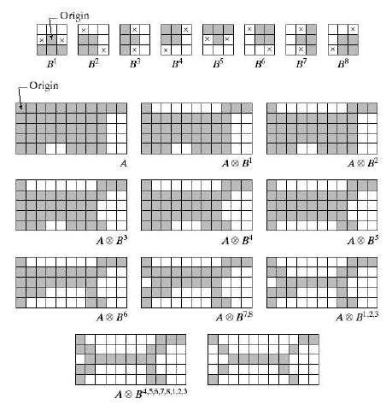
Thinning

Slide 39

Thickening
How It Works
    The thickened image consists of the original image plus any additional foreground pixels switched on by the hit-and-miss transform.
  Thickening is the dual of thinning.
    Thinning the foreground is equivalent to thickening the background.
  The operator is normally applied repeatedly until it causes no further changes to the image.
    c.f. The operations may only be applied for a limited number of iterations.
A: image, B: structuring element

Slide 40
Filters
We will mainly focus on two types of filters:
  Smoothing (low-pass)
  Sharpening (high-pass)

Slide 41
Smoothing Filters (low-pass)
Useful for reducing noise and eliminating small details.
  The elements of the mask must be positive.
  Sum of mask elements is 1 (after normalization).
Gaussian

Slide 42

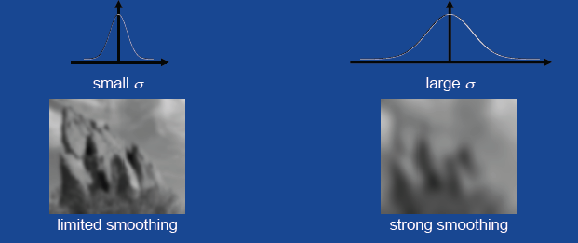
Smoothing filters – Example
input image
smoothed image

Slide 43
Sharpening Filters (high-pass)
Useful for highlighting fine details.
  The elements of the mask contain both positive and negative weights.
  Sum of mask elements is 0.
1st derivative
of Gaussian
2nd derivative
of Gaussian

Slide 44
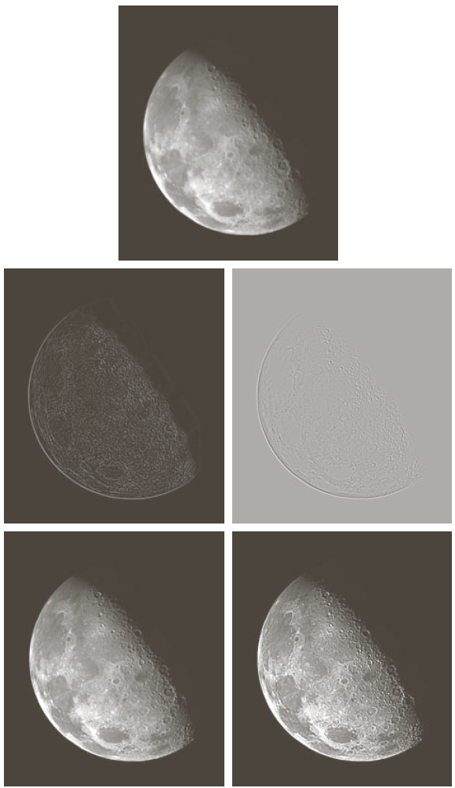
Sharpening Filters - Example
The results of sharpening might contain negative values (i.e., re-map them to [0, 255])
input image
sharpened image
(for better visualization, the original
image is added to the sharpened image)

Slide 45
Common Smoothing Filters
Averaging
Gaussian
Median filtering (non-linear)

Slide 46
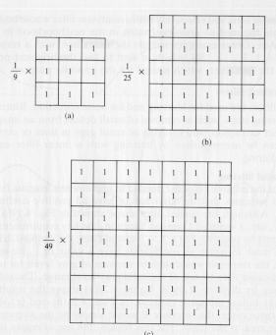
Smoothing Filters: Averaging

Slide 47
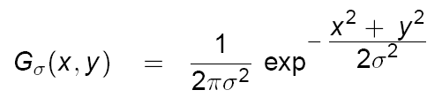
Smoothing filters: Gaussian
The weights are samples of a 2D Gaussian function:
σ = 1.4
mask size is
a function of σ:

Slide 48
Smoothing filters: Gaussian (cont’d)
σ controls the amount of smoothing
As σ increases, more samples must be obtained to represent
the Gaussian function accurately.
σ = 3

Slide 49
Smoothing filters: Gaussian (cont’d)

Slide 50
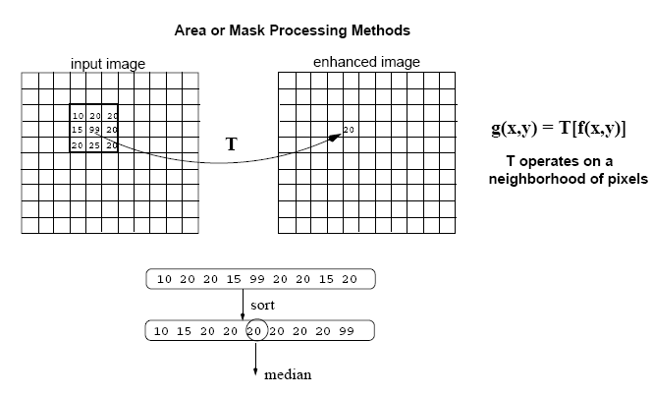
Smoothing Filters: Median Filtering (cont’d)
Replace each pixel by the median in a neighborhood around the pixel.
The size of the neighborhood controls the amount of smoothing.

Slide 51
Thank You

